Slide 1
NFA and Kleene’s Theorem

Slide 2
It may be observed that if an NFA can be built corresponding to union, concatenation and closure of FAs corresponding to the REs, then converting the NFA, thus, obtained into an equivalent FA, this FA will correspond to the given RE. Followings are the procedures showing how to obtain NFAs equivalent to union, concatenation and closure of FAs

Slide 3
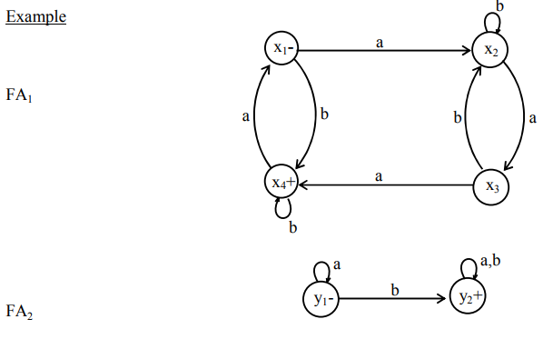
NFA corresponding to Union of FAs
Introduce a new start state and connect it with the states originally connected with the old start state with the same transitions as the old start state, then remove the –ve sign of old start state. This creates non-determinism and hence results in an NFA

Slide 4
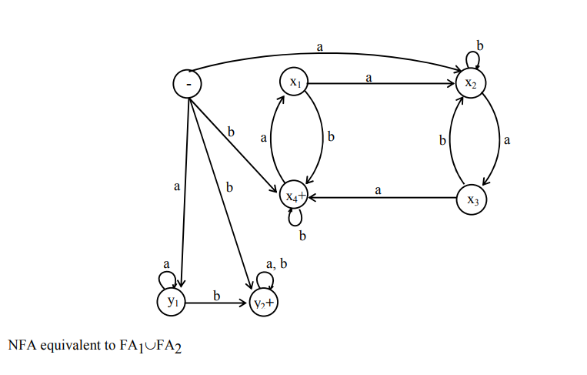

Slide 5
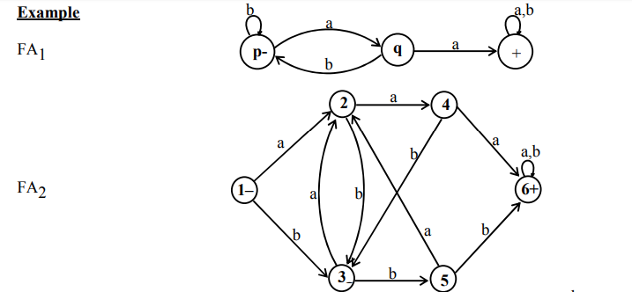
Example 2:

Slide 6
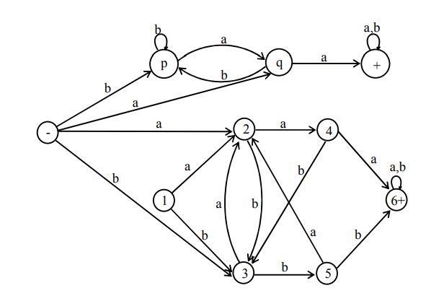
NFA equivalent to FA1∪FA2

Slide 7
NFA corresponding to Concatenation of FAs
Method
Introduce additional transitions for each letter connecting each final state of the first FA with the states of second FA that are connected with the initial state of second FA corresponding to each letter of the alphabet. Remove the +ve sign of each of final states of first FA and –ve sign of the initial state of second FA. It will create non-determinism at final states of first FA and hence NFA, thus obtained, will be the required NFA.

Slide 8
Note
It may be noted that if first FA accepts the Null string then every string accepted by second FA must be accepted by the concatenation of FAs as well. This situation will automatically be accommodated using the method discussed earlier. However if the second FA accepts Null string, then every string accepted by first FA must be accepted by the required FA as well. This target can be achieved as, while introducing new transitions at final states of first FA the +ve sign of these states will not be removed
Lastly if both FAs accepts the Null string, then the Null string must be accepted by the required FA. This situation will automatically be accommodated as the second FA accepts the Null string and hence the +ve signs of final states of first FA will not be removed.

Slide 9
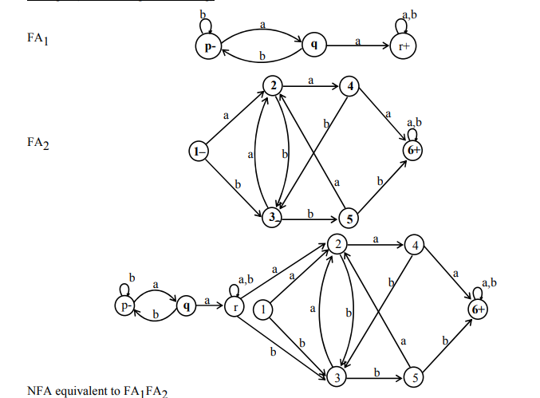

Slide 10
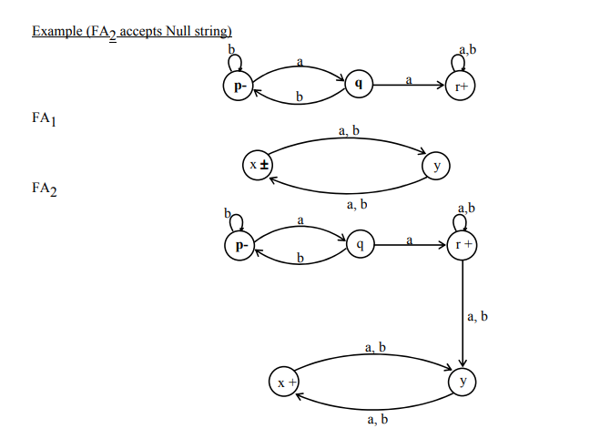

Slide 11
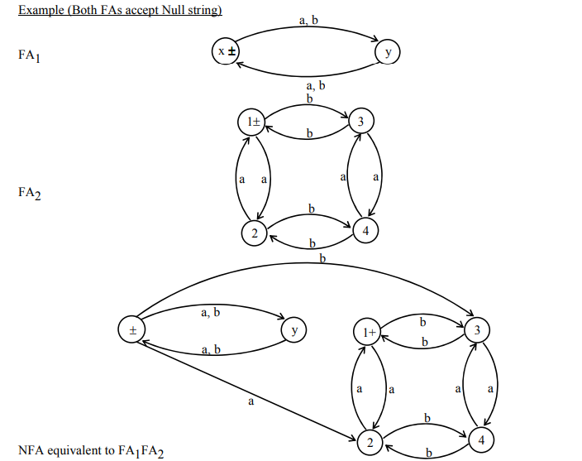

Slide 12
NFA corresponding to the Closure of an FA
Apparently, it seems that since closure of an FA accepts the Null string, so the required NFA may be obtained considering the initial state of given FA to be final as well, but this may allow the unwanted string to be accepted as well. For example, an FA, with two states, accepting the language of strings, defined over. Σ = {a, b}, ending in a, will accept all unwanted strings, if the initial state is supposed to be final as well.

Slide 13
Method
Thus, to accommodate this situation, introduce an initial state which should be final as well (so that the Null string is accepted) and connect it with the states originally connected with the old start state with the same transitions as the old start state, then remove the –ve sign of old start state. Introduce new transitions, for each letter, at each of the final states (including new final state) with those connected with the old start state.This creates non-determinism and hence results in the required NFA

Slide 14
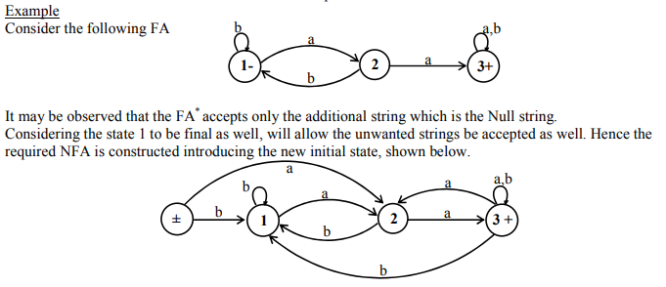

Slide 15
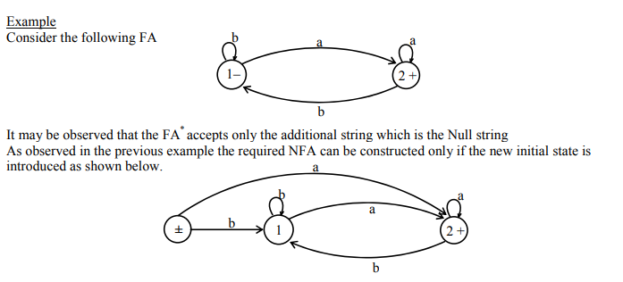

Slide 16
TG
If L1 and L2 are regular languages then L1 and L2 can also be expressed by some REs as well and hence using Kleene’s theorem, L1 and L2 can also be expressed by some TGs. Following are the methods showing that there exist TGs corresponding to L1 + L2, L1L2 and L1*

Slide 17
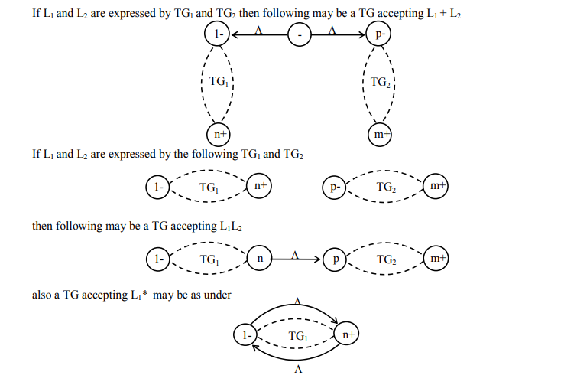

Slide 18
Complement of a language
Let L be a language defined over an alphabet Σ, then the language of strings, defined over Σ, not belonging to L, is called Complement of the language L, denoted by Lc or L’
To describe the complement of a language, it is very important to describe the alphabet of that language over which the language is defined. For a certain language L, the complement of Lc is the given language L i.e. (Lc ) c = L

Slide 19
Theorem If L is a regular language then, Lc is also a regular language
Proof
Since L is a regular language, so by Kleene’s theorem, there exists an FA, say F, accepting the language L. Converting each of the final states of F to non-final states and old non-final states of F to final states, FA thus obtained will reject every string belonging to L and will accept every string, defined over Σ, not belonging to L. Which shows that the new FA accepts the language Lc . Hence using Kleene’s theorem Lc can be expressed by some RE. Thus Lc is regular.

Slide 20
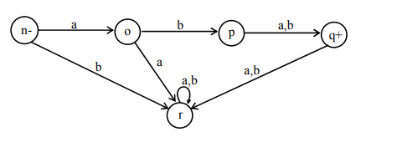
Example Let L be the language over the alphabet Σ = {a, b}, consisting of only two words aba and abb, then the FA accepting L may be

Slide 21
Theorem If L1 and L2 are two regular languages, then L1 ∩ L2 is also regular.
Proof Using De-Morgan's law for sets (L1 c ∪ L2 c ) c = (L1 c ) c ∩ (L2 c ) c = L1 ∩ L2 Since L1 and L2 are regular languages, so are L1 c and L2 c . L1 c and L2 c being regular provide that L1 c ∪ L2 c is also regular language and so (L1 c ∪ L2 c ) c = L1 ∩ L2, being complement of regular language is regular language

Slide 22
Pumping Lemma
Statement
Let L be any infinite regular language (that has infinite many words), defined over an alphabet ∑ then there exist three strings x, y and z belonging to ∑ * (where y is not the null string) such that all the strings of the form xyn z for n=1,2,3, … are the words in L.

Slide 23
Proof
If L is a regular language, then according to Kleene’s theorem, there exists an FA, say, F that accepts this language. Now F, by definition, must have finite no of states while the language has infinitely many words, which shows that there is no restriction on the length of words in L, because if there were such restriction then the language would have finite many words. Let w be a word in the language L, so that the length of word is greater than the number of states in F. In this case the path generated by the word w, is such that it cannot visit a new state for each letter i.e. there is a circuit in this path. The word w, in this case, may be divided into three parts The substring which generates the path from initial state to the state which is revisited first while reading the word w. This part can be called x and x can be a null string.

Slide 24
The substring which generates the circuit starting from the state which was lead by x. This part can be called as y which cannot be null string. The substring which is the remaining part of the word after y, call this part as z. It may be noted that this part may be null string as the word may end after y or z part may itself be a circuit. Thus the word may be written as w = xyz where x,y and z are the strings, also y can’t be a null string. Now this is obvious that, looping the circuit successively, the words xyyz, xyyyz, xyyyz, … will also be accepted by this FA i.e. xy n z, n=1,2,3, … will be words in L

Slide 25
Remark: In the above theorem, it is not affected if the z-part has circuit. To prove the theorem it is only to find a circuit and then looping that circuit, is all that is needed. While looping the circuit the volume of the string y (or z) is pumped, so the theorem is also called the Pumping lemma. Following are the examples

Slide 26
Let the word w = bbbababa, belonging to the language L, so that the length of word is greater than 6 (the number of states in F).
In this case the path generated by this word is such that it cannot visit a new state for each letter i.e. there is a circuit in this path.
The word w, in this case, may be divided into three parts.
The substring which generates the path from initial state to the state which is revisited first while reading the word w. This can be called as part x and this may be null string.
The substring which generates the circuit starting from the start state which was lead by x, this part can be called as y and this cannot be null string.
The substring which is the remaining part of the word after y, this part can be called as z. It may be noted that this part may be null string as the word may end after y or z-part may itself be a circuit.
Thus the word w may be written as w = xyz, where x,y,z are strings belonging to ∑ * and y cannot be null string. The state 2 is such that it is revisited first while reading the word w. So the word w can be decomposed, according to pumping lemma, as w = xyz = (b)(bba)(baba)
If y-part of w is continuously pumped, the resulting strings will be accepted by F and hence will be words in the language accepted by F. Thus, by pumping lemma, the language accepted by F is regular.

Slide 27
Remark: If the pumping lemma is applied directly on the language L = {an b n : n=0,1,2,3,…}, it can be observed that for the word w = (aaa)(aaaabbbb)(bbb) where x = aaa, y = aaaabbbb and z = bbb
xyyz will contain as many number of a’s as there are b’s but this string will not belong to L because the substring ab can occur at the most once in the words of L, while the string xyyz contains the substring ab twice.
On the other hand if y-part consisting of only a’s or b’s, then xyyz will contain number of a’s different from number of b’s. This shows that pumping lemma does not hold and hence the language is not regular.

